Slide 1

Testing Project for web application
Learner: Maria Manuela Iordache
Mentors: Oana Vancă, Ioana Blaga

Slide 2

APP Description
www.elefant.ro
web & mobile application
E-commerce
released on June17, 2010
110.000 products
categories: books, toys, watches, parfums, clothing, shoes, accessories, make-up and personal care, electronics and appliances

Slide 3
Testing Approach
Create a Mind map
Set a time to make sure that testing process is completed in agreed time
Exploratory testing: search bar; sign up
Manual test using Smoke for main functionalities
Compatibility and cross-browser testing: desktop, mobile, browsers
API tests with Postman: response time, status code, body correct/matches string
Automated tests using Cypress with Visual Studio Code
Document and validate all identified bugs
Analyze results and provide recommendations
Write Test Report for stakeholders

Slide 4
Tools Used
X Mind
Microsoft Office
Snipping tool for screenshots
Mantis – bug tracker
TestLink – test case management
Visual Studio Code – source-code editor
Cypress – automation testing tool
Postman – automation testing tool
Fake filler – form filler to fill input fields with randomly generated fake data

Slide 5
Testing Types
Manual testing
Exploratory testing
Smoke testing
Positive testing
Negative testing
Compatibility and performance testing
API testing
UI Testing

Slide 6
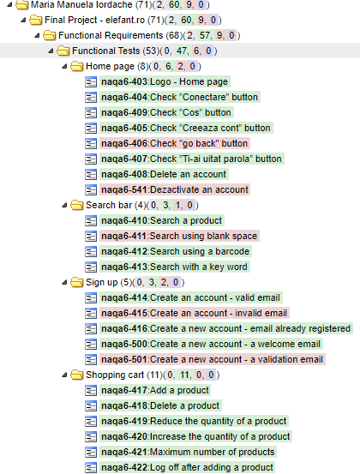

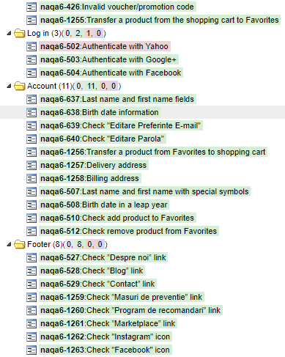

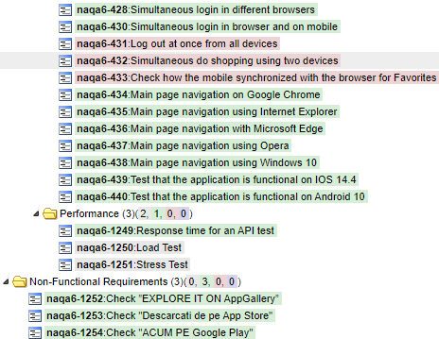

Test Cases Overview

Slide 7
Test Cases Results
Functional
Functionality | Total | Pass | Failed | Blocked | Not Run | Defects
Home page | 8 | 6 | 2 | 0 | 0 | 0031676, 0031675
Search bar | 4 | 3 | 1 | 0 | 0 | 0031951
Sign up | 5 | 3 | 2 | 0 | 0 | 0031668, 0031667
Shopping cart | 11 | 11 | 0 | 0 | 0
Log in | 3 | 2 | 1 | 0 | 0 | 0031677
Account | 11 | 11 | 0 | 0 | 0
Footer | 8 | 8 | 0 | 0 | 0
Products | 3 | 3 | 0 | 0 | 0
Overall Results | 53 | 47 | 6 | 0 | 0 | 6
Non-Functional
Product/Feature | Total | Pass | Failed | Blocked | Not Run | Defects
Compatibility | 12 | 9 | 3 | 0 | 0 | 0031670, 0031671, 0031672
Response Time for Home page | 1 | 1 | 0 | 0 | 0
Load Test for Main Page | 0 | 0 | 0 | 0 | 1
Stress Test for Shopping Cart | 0 | 0 | 0 | 0 | 1
Overall Results | 12 | 10 | 3 | 0 | 2

Slide 8
Bugs overview
Defect ID | Defect summary | Severity
0031667 | New account: create an account with an invalid email | normal
0031668 | New account: the user is not receiving a validation email | normal
0031670 | Log out at once from all devices is not happening | normal
0031671 | Shop using two devices in the same time is not possible | normal
0031672 | The Favorites section on two devices is not synchronized | normal
0031675 | Back button: The user is not redirected to login page | normal
0031676 | Dezactivare cont is inactive | normal
0031677 | Authenticate with Yahoo is not available | normal
0031951 | Search bar: Click without typing and then press enter | normal
0031952 | Search bar: Type one letter and press enter | normal
0031953 | Search bar: Type a number and press enter | normal
0031954 | Search bar: Type special chars and press enter | normal
0031955 | Search bar: Type alphanumeric characters and press enter | normal
0031956 | Search bar: Type a piece of script and press enter | normal
0031957 | Search bar: Type an URL and press enter | normal
0031958 | Sign up with special chars | normal
0031959 | Sign up: insert email address as a password | normal

Slide 9
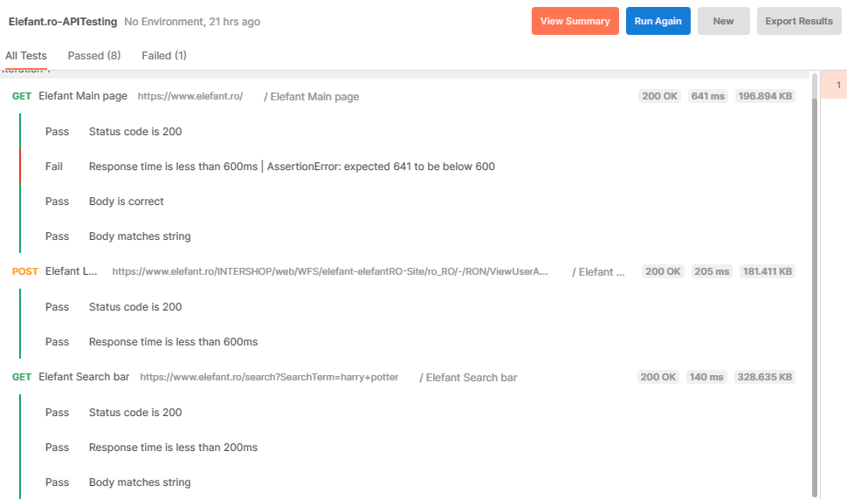
API Tests

Slide 10
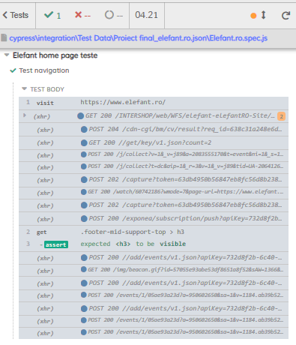
UI Tests
///references types="Cypress"/>
describe("Elefant home page teste",()=>{
beforeEach(()=>{
Cypress.on('uncaught:exception',(err, runnable)=>{
// returning false here prevents Cypress from
// failing the test
return false;
})
})
it.only("Test navigation",()=>{
cy.visit("https://www.elefant.ro/");
cy.get('.footer-mid-support- top > h3').should("be.visible");
})
})

Slide 11

Conclusions
69 test cases were executed - 9 failed
Exploratory testing – 8 bugs
2 automated tests were executed with Cypress – all passed
9 automated tests were executed with Postman – 1 failed
Total results: 17 bugs were found & 3 improvements
Good coverage: 74%

Slide 12
Lessons Learned
Be in Time
Think Outside the Box
Attention to Details
Transparent Communication
Be Organized
Understand your Product
Write Clear and Complete Test Cases

Slide 13
Thank you!

